Slide 1
Machine Learning An Algorithm Perspective
Second Edition
by Stephen Marsland

Slide 2
CHAPTER 4 The Multi-layer Perceptron
the majority of interesting problems are not linearly separable.
add neurons between the input nodes and the outputs, and this will make more complex neural networks, the Multi-layer Perceptron (MLP),

Slide 3
4.1 GOING FORWARDS
training the MLP consists of two parts:
working out what the outputs are for the given inputs and the current weights,
and then updating the weights according to the error,
which is a function of the difference between the outputs and the targets.
These are generally known as going forwards and backwards through the network.

Slide 4
Going Forwards
use inputs and the first level of weights to calculate the activations of the hidden layer,
and then we use those activations and the next set of weights to calculate the activations of the output layer.
compare output to the targets and compute the error.

Slide 5
4.1.1 Biases
We need to include a bias input to each neuron.
by having an extra input that is permanently set to -1,
and adjusting the weights to each neuron as part of the training.

Slide 6
4.2 GOING BACKWARDS: BACK-PROPAGATION OF ERROR
The method is called back-propagation of error,
which makes it clear that the errors are sent backwards through the network.
It is a form of gradient descent
The error function that we used for the Perceptron was
where N is the number of output nodes.
the sum-of-squares error function

Slide 7
if we differentiate a function, then it tells us the gradient of that function, which is the direction along which it increases and decreases the most.
So if we differentiate an error function, we get the gradient of the error.
Since the purpose of learning is to minimise the error, following the error function downhill (in other words, in the direction of the negative gradient) will give us what we want.

Slide 8
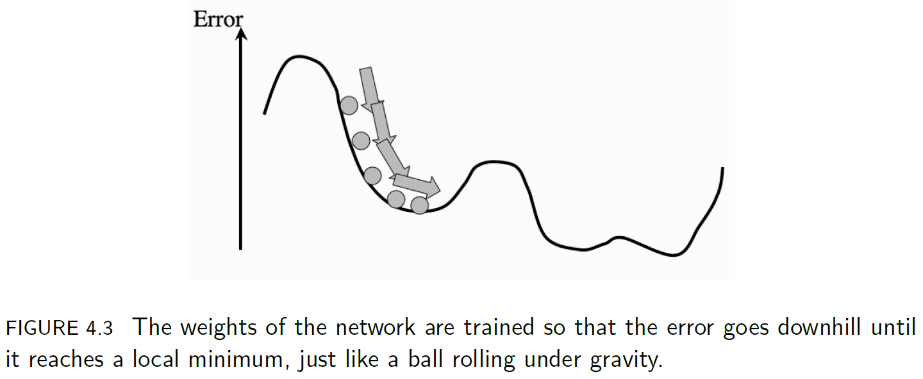

Slide 9
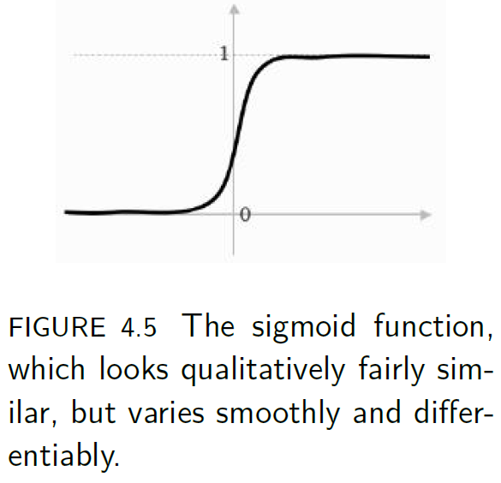
the activation function
There is a mathematical form of S-shaped functions, called sigmoid functions. β>0
which is the hyperbolic tangent function.

Slide 10
the hyperbolic tangent function is still a sigmoid function,
but it saturates (reaches its constant values) at ±1 instead of 0 and 1.
derivative: d/dx tanh x = (1 − tanh²(x)).
So now we've got
a new form of error computation (sum-of-squares error)
and a new activation function (hyperbolic tangent)

Slide 11
We can differentiate it, so that when we change the weights, we do it in the direction that is downhill for the error,
which means that we know we are improving the error function of the network.
As far as an algorithm goes, we've fed our inputs forward through the network and worked out which nodes are firing.
Now, at the output, we've computed the errors as the sum-squared difference between the outputs and the targets ).

Slide 12
What we want to do next is
to compute the gradient of these errors
and use them to decide how much to update each weight in the network.
We will do that first for the nodes connected to the output layer,
and after we have updated those, we will work backwards through the network until we get back to the inputs again.

Slide 13
There are just two problems:
for the output neurons, we don't know the inputs.
for the hidden neurons, we don't know the targets;
for extra hidden layers, we know neither the inputs nor the targets.
use the chain rule of differentiation
we can write the activations of the output nodes in terms of the activations of the hidden nodes and the output weights,
and then we can send the error calculations back through the network to the hidden layer to decide what the target outputs were for those neurons.

Slide 14
This leads to two different update functions,
one for each of the sets of weights,
and we just apply these backwards through the network,
starting at the outputs and ending up back at the inputs.

Slide 15
4.2.1 The Multi-layer Perceptron Algorithm
some practical issues, such as
how much training data is needed,
how much training time is needed,
and how to choose the correct size of network.
We will assume that there are
L input nodes, plus the bias,
M hidden nodes, also plus a bias,
and N output nodes,
so that there are
(L+1)×M weights between the input and the hidden layer
and (M+1)×N between the hidden layer and the output.

Slide 16
The sums that we write will start from 0 if they include the bias nodes and 1 otherwise, and run up to L, M, or N,
so that x₀ = −1 is the bias input, and a₀ = −1 is the bias hidden node.
The algorithm that is described could have any number of hidden layers,
in which case there might be several values for M, and extra sets of weights between the hidden layers.
We will also use i, j, k to index the nodes in each layer in the sums, and the corresponding Greek letters (ι, ζ, κ) for fixed indices.

Slide 17
the full MLP training algorithm using back-propagation of error
an input vector is put into the input nodes
the inputs are fed forward through the network
the inputs and the first-layer weights (here labelled as v) are used to decide whether the hidden nodes fire or not.
The activation function g(·) is the sigmoid function
the outputs of these neurons and the second-layer weights (labelled as w) are used to decide if the output neurons fire or not

Slide 18
the error is computed as the sum-of-squares difference between the network outputs and the targets
this error is fed backwards through the network in order to
first update the second-layer weights W
and then afterwards, the first-layer weights V

Slide 19
The Multi-layer Perceptron Algorithm
Initialisation
initialise all weights to small (positive and negative) random values
Training
repeat:
for each input vector:
Forwards phase:
compute the activation of each neuron j in the hidden layer(s) using:

Slide 20
work through the network until you get to the output layer neurons, which have activations

Slide 21

Backwards phase:
compute the error at the output using:
compute the error in the hidden layer(s) using:
update the output layer weights using:

Slide 22
update the hidden layer weights using:
v_{Lζ}←v_{Lζ} −ηδ_{h}(ζ)x_{L}
(if using sequential updating) randomise the order of the input vectors so that you don’t train in exactly the same order each iteration
until learning stops
Recall
use the Forwards phase in the training section above

Slide 23
there are some important things that need to be considered, such as
how many training datapoints are needed,
how many hidden nodes should be used,
and how much training the network needs.

Slide 24
4.2.2 Initialising the Weights
The MLP algorithm suggests that the weights are initialised to small random numbers, both positive and negative.
The question is how small is small, and does it matter?
why they should be small we can look at the shape of the sigmoid.
If the initial weight values are close to 1 or -1 (which is what we mean by large here) then the inputs to the sigmoid are also likely to be close to ±1
and so the output of the neuron is either 0 or 1 (the sigmoid has saturated, reached its maximum or minimum value).
If the weights are very small (close to zero) then the input is still close to 0
and so the output of the neuron is just linear, so we get a linear model.

Slide 25
Choosing the size of the initial values
Each neuron is getting input from n different places(input nodes or hidden neurons)
If we view the values of these inputs as having uniform variance, then the typical input to the neuron will be w √n, where w is the initialisation value of the weights.
So a common trick is to set the weights in the range −1/√n < w < 1/√n, where n is the number of nodes in the input layer to those weights.
This makes the total input to a neuron have a maximum size of about 1.

Slide 26
if the weights are large, then the activation of a neuron is likely to be at, or close to, 0 or 1 already,
which means that the gradients are small, and so the learning is very slow.
There is an interplay here with the value of β in the logistic function,
which means that small values of β (say β = 3.0 or less) are more effective.
we keep them all about the same size because we want all of the weights to reach their final values at about the same time.
This is known as uniform learning
and it is important because otherwise the network will do better on some inputs than others.

Slide 27
4.2.3 Different Output Activation Functions
In the algorithm described above, we used sigmoid neurons in the hidden layer and the output layer.
This is fine for classification problems, since there we can make the classes be 0 and 1.
to perform regression problems,
needs to be from a continuous range, not just 0 or 1.
The sigmoid neurons at the output are not very useful in that case.
the output neurons with linear nodes that just sum the inputs and give that as their activation (so g(h) = h)

Slide 28

A third type of output neuron
That is the soft-max activation function.
This is most commonly used for classification problems where the 1-of-N output encoding is used.
The soft-max function rescales the outputs by calculating the exponential of the inputs to that neuron, and dividing by the total sum of the inputs to all of the neurons, so that the activations sum to 1 and all lie between 0 and 1.

Slide 29
if we change the activation function, then the derivative of the activation function will also change, and so the learning rule will be different.
For the linear activation function the first is replaced by:
yκ = g(hκ) = hκ
while the second is replaced by:
δo(κ) = (yκ − tκ)
For the soft-max activation, the update equation that replaces (4.8) is
δo(κ) = (yκ − tκ)yκ(δκK − yK), (4.15)
where δκK = 1 if κ = K and 0 otherwise;

Slide 30

if we modify the error function as well, to have the cross-entropy form (where ln is the natural logarithm):
then the delta term is δo(κ) = (yκ − tκ)
Computing these update equations requires computing the error function that is being optimised, and then differentiating it.

Slide 31
Cross entropy
Definition
The cross entropy for the distributions p and q over a given set is defined as follows:
H(p,q)=E_{p}[-log q]
For discrete probability distributions p and q with the same support X this means
https://en.wikipedia.org/wiki/Cross_entropy
https://www.cnblogs.com/silent-stranger/p/7987708.html explained in Mandarin

Slide 32
4.2.4 Sequential and Batch Training
The MLP is designed to be a batch algorithm.
All of the training examples are presented to the neural network, the average sum-of-squares error is then computed, and this is used to update the weights.
Thus there is only one set of weight updates for each epoch (pass through all the training examples).
This means that we only update the weights once for each iteration of the algorithm, which means that the weights are moved in the direction that most of the inputs want them to move, rather than being pulled around by each input individually.
The batch method performs a more accurate estimate of the error gradient, and will thus converge to the local minimum more quickly.

Slide 33
The sequential version
where the errors are computed and the weights updated after each input.
This is not guaranteed to be as efficient in learning, but it is simpler to program when using loops, and it is therefore much more common.
Since it does not converge as well, it can also sometimes avoid local minima, thus potentially reaching better solutions.
In a sequential version, the order of the weight updates can matter, which is why the pseudocode version of the algorithm include a suggestion about randomising the order of the input vectors at each iteration.
This can significantly improve the speed with which the algorithm learns.

Slide 34
4.2.5 Local Minima
The driving force behind the learning rule is the minimisation of the network error by gradient descent (using the derivative of the error function to make the error smaller).
That means that we are performing an optimisation:
we are adapting the values of the weights in order to minimise the error function.
The way that we are doing this is by approximating the gradient of the error and following it downhill so that we end up at the bottom of the slope.
However, following the slope downhill only guarantees that we end up at a local minimum, a point that is lower than those close to it.

Slide 35
We can make it more likely that we find the global minimum by trying out several different starting points by training several different networks, and this is commonly done.
However, we can also try to make it less likely that the algorithm will get stuck in local minima.

Slide 36
4.2.6 Picking Up Momentum
The reason that the ball stops rolling is because it runs out of energy at the bottom of the dip.
If we give the ball some weight, then it will generate momentum as it rolls, and so it is more likely to overcome a small hill on the other side of the local minimum, and so more likely to find the global minimum.
We can implement this idea in our neural network learning by
adding in some contribution from the previous weight change that we made to the current one.
In two dimensions it will mean that the ball rolls more directly towards the valley bottom, since on average that will be the correct direction, rather than being controlled by the local changes.

Slide 37


There is another benefit to momentum.
It makes it possible to use a smaller learning rate, which means that the learning is more stable.
the weight updates
Δω_{ζκ}^{t-1}is the previous update that we made to the weights (so
and 0 < α < 1 is the momentum constant. Typically a value of α = 0.9 is used.

Slide 38
Another thing that can be added is known as weight decay.
This reduces the size of the weights as the number of iterations increases.
The argument goes that small weights are better since they lead to a network that is closer to linear (since they are close to zero, they are in the region where the sigmoid is increasing linearly),
and only those weights that are essential to the non-linear learning should be large.
After each learning iteration through all of the input patterns, every weight is multiplied by some constant 0 < ε < 1.
This makes the network simpler and can often produce improved results,
but unfortunately, it isn’t fail-safe: occasionally it can make the learning significantly worse, so it should be used with care. Setting the value of ε is typically done experimentally.

Slide 39
4.2.7 Minibatches and Stochastic Gradient Descent
The idea of a minibatch method is to find some happy middle ground between the batch and squential,
by splitting the training set into random batches,
estimating the gradient based on one of the subsets of the training set,
performing a weight update,
and then using the next subset to estimate a new gradient and using that for the weight update, until all of the training set have been used.
The training set are then randomly shuffled into new batches and the next iteration takes place.

Slide 40
If the batches are small, then there is often a reasonable degree of error in the gradient estimate,
and so the optimisation has the chance to escape from local minima, albeit at the cost of heading in the wrong direction.

Slide 41
Stochastic gradient descent
A more extreme version of the minibatch idea is
to use just one piece of data to estimate the gradient at each iteration of the algorithm,
and to pick that piece of data uniformly at random from the training set.
So a single input vector is chosen from the training set, and the output and hence the error for that one vector computed, and this is used to estimate the gradient and so update the weights.
A new random input vector (which could be the same as the previous one) is then chosen and the process repeated.
This is known as stochastic gradient descent, and can be used for any gradient descent problem, not just the MLP.
It is often used if the training set is very large, since it would be very expensive to use the whole dataset to estimate the gradient in that case

Slide 42
4.2.8 Other Improvements
To improve the convergence and behaviour of the back-propagation algorithm.
One is to reduce the learning rate as the algorithm progresses.
The reasoning behind this is that the network should only be making large-scale changes to the weights at the beginning, when the weights are random;
if it is still making large weight changes later on, then something is wrong.

Slide 43
Something that results in much larger performance gains is to include information about the second derivatives of the error, with respect to the weights.
In the back-propagation algorithm we use the first derivatives to drive the learning.
However, if we have knowledge of the second derivatives as well, we can use them as well to improve the network.

Slide 44
4.3 THE MULTI-LAYER PERCEPTRON IN PRACTICE
To apply these ideas to using the MLP to find solutions to four different types of problem:
regression,
classification,
time-series prediction,
and data compression.

Slide 45
4.3.1 Amount of Training Data
For the MLP with one hidden layer there are (L + 1) × M + (M + 1) × N weights,
where L, M, N are the number of nodes in the input, hidden, and output layers, respectively.
Setting the values of these weights is the job of the back-propagation algorithm, which is driven by the errors coming from the training data.
Clearly, the more training data there is, the better for learning, although the time that the algorithm takes to learn increases.
A rule of thumb that has been around for almost as long as the MLP itself is that you should use a number of training examples that is at least 10 times the number of weights.

Slide 46
4.3.2 Number of Hidden Layers
To choose the number of hidden nodes, and the number of hidden layers.
Two hidden layers is the most that you ever need for normal MLP learning.
In fact, one hidden layer with lots of hidden nodes is sufficient. This is known as the Universal Approximation Theorem;
there is no theory to guide the choice of the number of hidden nodes.
You just have to experiment by training networks with different numbers of hidden nodes and then choosing the one that gives the best results,

Slide 47
We will never normally need more than two layers (that is, one hidden layer and the output layer).
This is because we can approximate any smooth functional mapping using a linear combination of localised sigmoidal functions.
The basic idea is that
by combining sigmoid functions we can generate ridge-like functions,
and by combining ridge-like functions we can generate functions with a unique maximum.

Slide 48
By combining these and transforming them using another layer of neurons, we obtain a localised response (a ‘bump’ function),
and any functional mapping can be approximated to arbitrary accuracy using a linear combination of such bumps.

Slide 49
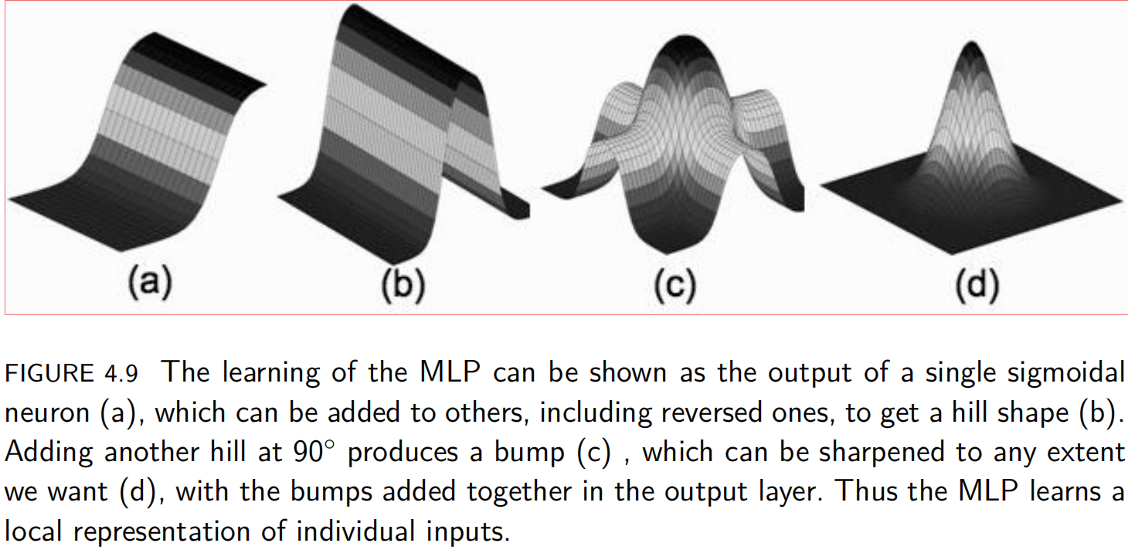

Slide 50
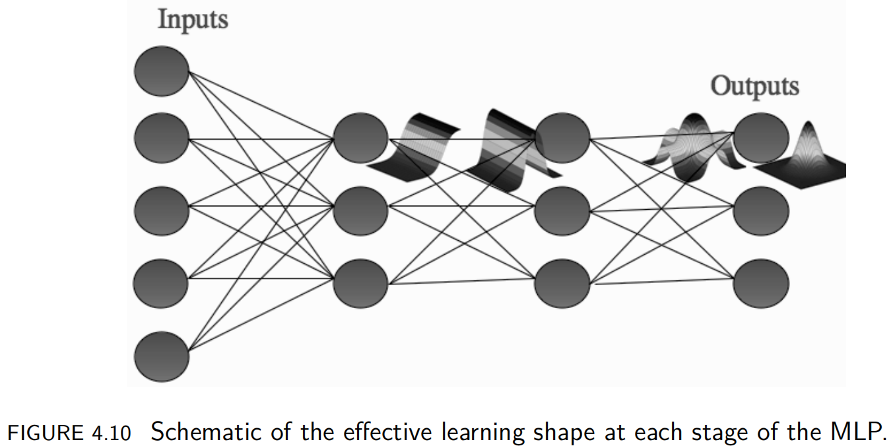

Slide 51
4.3.3 When to Stop Learning
The training of the MLP requires that the algorithm runs over the entire dataset many times, with the weights changing as the network makes errors in each iteration.
The question is
how to decide when to stop learning

Slide 52
the most obvious options are not sufficient:
setting some predefined number N of iterations, and running until that is reached runs the risk that
the network has overfitted by then,
or not learnt sufficiently, and only stopping when some predefined minimum error is reached
might mean the algorithm never terminates, or that it overfits.
Using both of these options together can help, as can terminating the learning once the error stops decreasing.

Slide 53
The validation set gives us something rather more useful, since we can use it to monitor the generalisation ability of the network at its current stage of learning.
If we plot the sum-of-squares error during training, it typically reduces fairly quickly during the first few training iterations, and then the reduction slows down as the learning algorithm performs small changes to find the exact local minimum.
We don't want to stop training until the local minimum has been found, but, keeping on training too long leads to overfitting of the network.

Slide 54
This is where the validation set comes in useful.
We train the network for some predetermined amount of time, and then use the validation set to estimate how well the network is generalising.
We then carry on training for a few more iterations, and repeat the whole process.

Slide 55
At some stage the error on the validation set will start increasing again, because the network has stopped learning about the function that generated the data, and started to learn about the noise that is in the data itself.
At this stage we stop the training.
This technique is called early stopping.

Slide 56
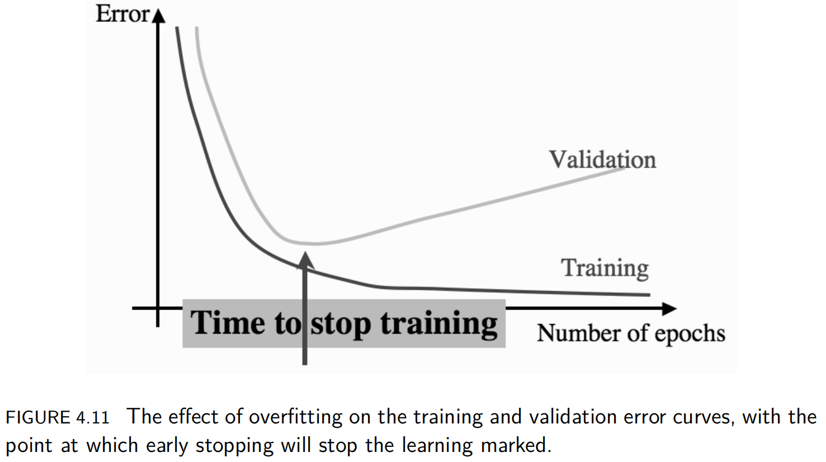

Slide 57
4.5 A RECIPE FOR USING THE MLP Select inputs and outputs for your problem
At this stage you need to choose what features are suitable for the problem
and decide on the output encoding that you will use — standard neurons, or linear nodes.
These things are often decided for you by the input features and targets that you have available to solve the problem.
it can also be useful to re-evaluate the choice by training networks with some input feature missing to see if it improves the results at all.

Slide 58
Normalise inputs
Rescale the data by subtracting the mean value from each element of the input vector,
and divide by the variance (or alternatively, either the maximum or
minus the minimum, whichever is greater).

Slide 59
Split the data into training, testing, and validation sets
We generally split the data into three sets,
one for training,
one for testing,
and then a third set for validation, which is testing how well the network is learning during training.
The ratio between the sizes of the three groups depends on how much data you have, but is often around 50:25:25.
If you do not have enough data for this, use cross-validation instead.

Slide 60
Select a network architecture
You need to consider whether you will need a hidden layer at all, and if so how many neurons it should have in it.
You might want to consider more than one hidden layer.
The more complex the network, the more data it will need to be trained on, and the longer it will take.
It might also be more subject to overfitting.
The usual method of selecting a network architecture is to try several with different numbers of hidden nodes and see which works best.

Slide 61
Train a network
The training of the neural network consists of applying the Multi-layer Perceptron algorithm to the training data.
This is usually run in conjunction with early stopping, where after a few iterations of the algorithm through all of the training data, the generalisation ability of the network is tested by using the validation set.
The neural network is very likely to have far too many degrees of freedom for the problem, and so after some amount of learning it will stop modelling the generating function of the data, and start to fit the noise and inaccuracies inherent in the training data.
At this stage the error on the validation set will start to increase, and learning should be stopped.

Slide 62
Test the network
This will enable you to see how well the network performs on some data that it has not seen before,
and will tell you whether this network is likely to be usable for other data, for which you do not have targets.

Slide 63
4.6 DERIVING BACK-PROPAGATION 4.6.1 The Network Output and the Error
The output of the neural network is a function of three things:
the current input (x)
the activation function g(·) of the nodes of the network
the weights of the network (v for the first layer and w for the second)
The weights are the only things that we can vary to improve the performance of the network, i.e., to make it learn.
we have run the algorithm forwards, so that we have
fed the inputs (x) into the algorithm,
used the first set of weights (v) to compute the activations of the hidden neurons,
then those activations and the second set of weights (w) to compute the activations of the output neurons, which are the outputs of the network (y).
i,j,k will be the index of inpute, hidden and output layer respectively.

Slide 64
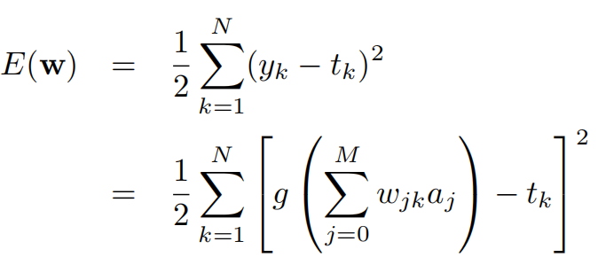
4.6.2 The Error of the Network
the difference between the outputs y and the targets t,
but I'm going to write it as E(v, w) to remind us that the only things that we can change are the weights v and w, and that changing the weights changes the output, which in turn changes the error.
we’ll choose the sum-of-squares error function, which calculates the difference between y_{k} and t_{k} for each node k.

Slide 65
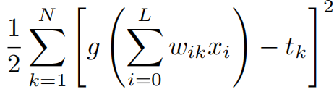
Just consider the situation without hidden layer--The simplest case
E(w) will be
The activation function is linear, which is
We are going to use a gradient descent algorithm that adjusts each weight wικ for fixed values of ι and κ, in the direction of the negative gradient of E(w).

Slide 66
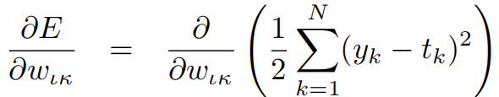

Slide 67

So the weight update rule (when we include the learning rate η) is:

Slide 68

4.6.3 Requirements of an Activation Function
In order to model a neuron we want an activation function that has the following properties:
it must be differentiable so that we can compute the gradient
it should saturate (become constant) at both ends of the range, so that the neuron either fires or does not fire
it should change between the saturation values fairly quickly in the middle
There is a family of functions called sigmoid functions because they are S-shaped.
The form in which it is generally used is:
where β is some positive parameter.

Slide 69
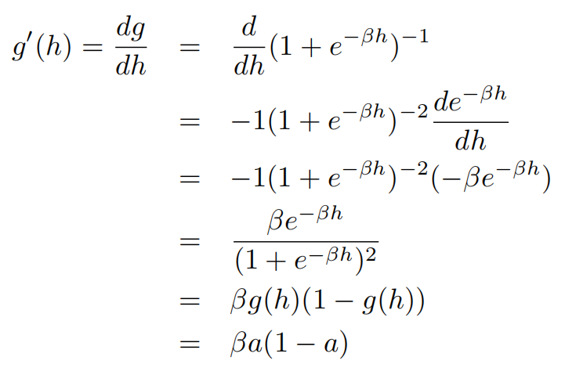
The derivative of sigmoid function is

Slide 70
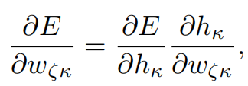
4.6.4 Back-Propagation of Error
where is the input to output-layer neuron κ;
that is, the sum of the activations of the hidden-layer neurons multiplied by the relevant (second-layer) weights.
It tells us that if we want to know how the error at the output changes as we vary the second-layer weights, we can think about how the error changes as we vary the input to the output neurons, and also about how those input values change as we vary the weights

Slide 71
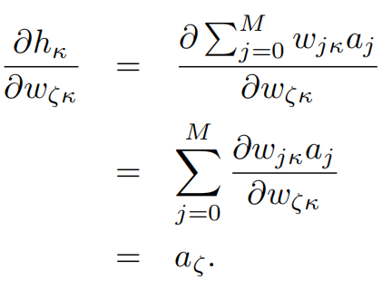

Slide 72
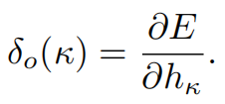
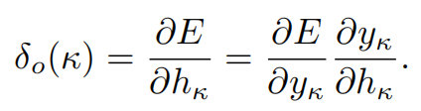
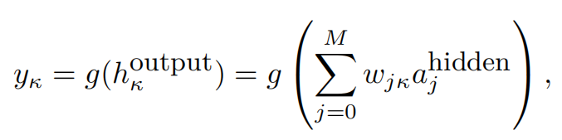
the error or delta term:

Slide 73
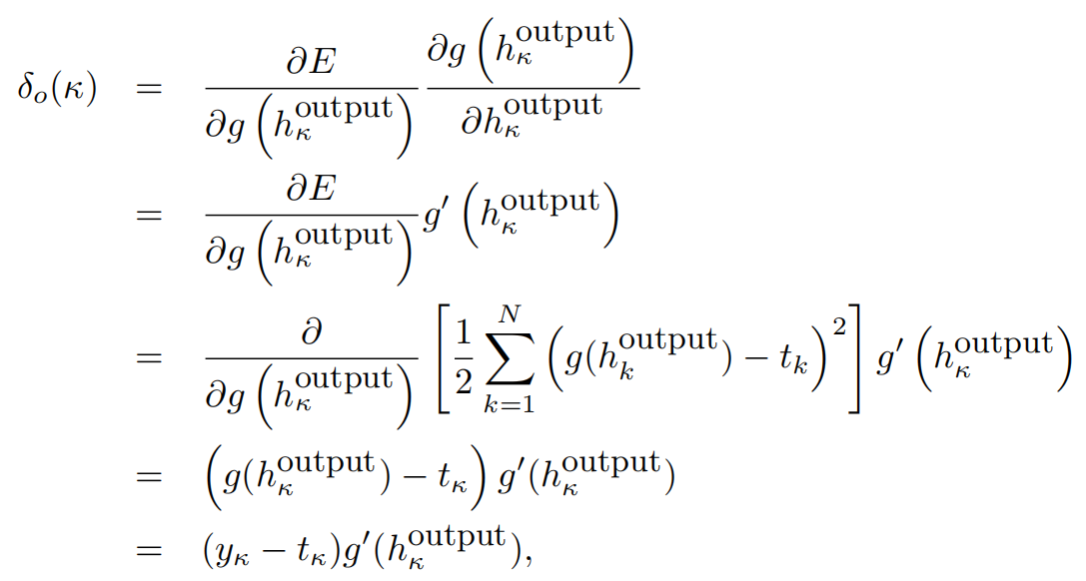

Slide 74
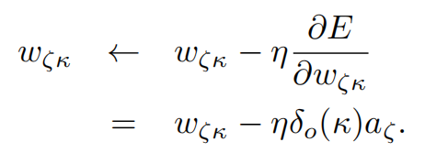
So for now we will write the update equation for the output layer weights in a slightly general form:
where we are using the minus sign because we want to go downhill to minimise the error.

Slide 75
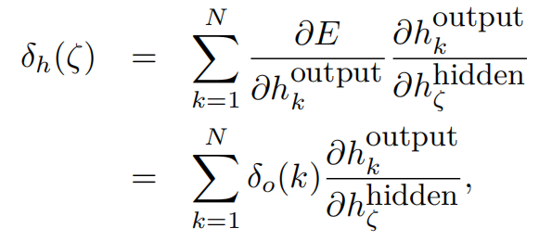
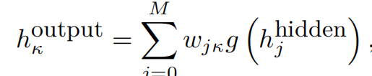
the first layer weights, v_{ιζ}, which connects input ι to hidden node ζ.
The way to think about this is that each hidden node contributes to the activation of all of the output nodes, and so we need to consider all of these contributions (with the relevant weights).

Slide 76

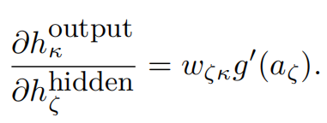
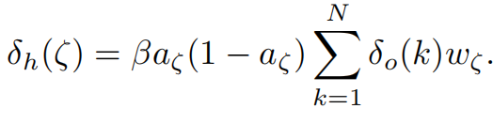
We can now use a fact which is that unless j = ζ, when it is 1.
So:
The hidden nodes always have sigmoidal activation functions, so

Slide 77
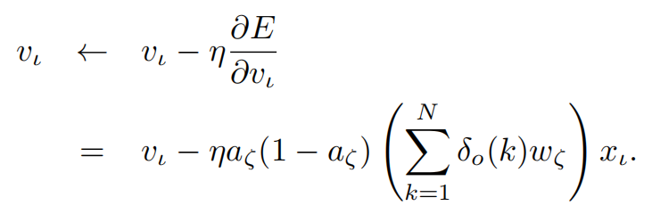
This means that the update rule for v_{ιζ} is:
ηβ

Slide 78
4.6.5 The Output Activation Functions
The sigmoidal activation function that we have created is aimed at making the nodes act a bit like neurons, either firing or not firing.
This is very important in the hidden layer,
we have observed two cases where the sigmoidal function is not suitable for the output neurons
One was regression, where we want the output to be continuous,
and one was multi-class classification, where we want only one of the output neurons to fire.

Slide 79
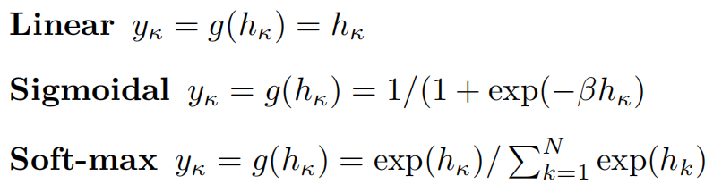
the three activation functions are:
for linear outputs δo(κ) = (yκ −tκ),
while for sigmoidal outputs it is δo(κ) = β(yκ − tκ)yκ(1 − yκ)

Slide 80
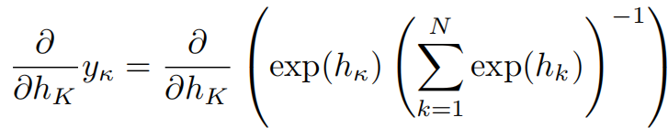
the δo(κ) in the soft-max case
the k index runs over all the output nodes, and
so includes K and κ within it.
There are two cases: either K = κ, or it does not.

Slide 81
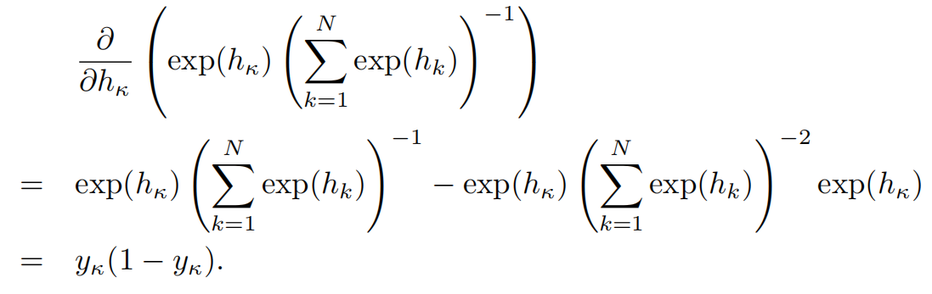
K=κ

Slide 82
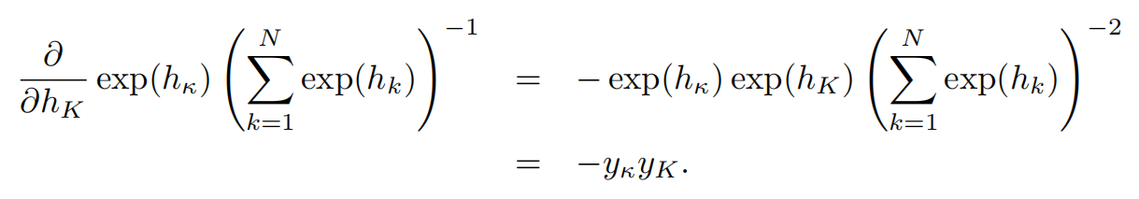

K≠κ
Using the Kronecker delta function δij , which is 1 if i = j and 0 otherwise,
we can write the two cases in one equation to get the delta term:

Slide 83
4.6.6 An Alternative Error Function
For classification tasks, we are assuming that the outputs represent different, independent classes,
and this means that we can think of the activations of the nodes as giving us a probability that each class is the correct one.
In this probabilistic interpretation of the outputs, we can ask how likely we are to see each target given the set of weights that we are using.
This is known as the likelihood and the aim is to maximise it, so that we predict the targets as well as possible.

Slide 84

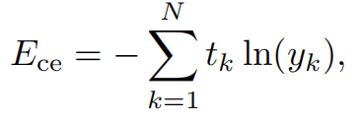
If we have a 1 output node, taking values 0 or 1, then the likelihood is:
In order to turn this into a minimisation function we put a minus sign in front, and it will turn out to be useful to take the logarithm of it as well, which produces the cross-entropy error function, which is (for N output nodes):

Slide 85
This error function has the nice property that when we use the soft-max function
the derivatives are very easy because the exponential and logarithm are inverse functions,
and so the delta term is simply δo(κ) = yκ − tκ

Slide 86
4.4 EXAMPLES OF USING THE MLP 4.4.1 A Regression Problem
We will take a set of samples generated by a simple mathematical function, and try to learn the generating function so that we can find the values of any inputs, not just the ones we have training data for.
import numpy as np
import matplotlib.pyplot as plt
nTotal=40
inputs=np.ones((1,nTotal))*np.linspace(0,1,nTotal)
targets=np.sin(2*np.pi*inputs)+np.cos(4*np.pi*inputs)+np.random.randn(nTotal)*0.2
inputs=inputs.T
targets=targets.T

Slide 87
because we want the output to be the value of the function, rather than 0 or 1, we will use linear neurons at the output.
The activation function of hidden node is still sigmoidal function.
Before getting started, we need to normalise the data using the method, and then separate the data into training, testing, and validation sets.
data = (data - data.mean(axis=0))/data.var(axis=0)
targets = (targets - targets.mean(axis=0))/targets.var(axis=0)

Slide 88
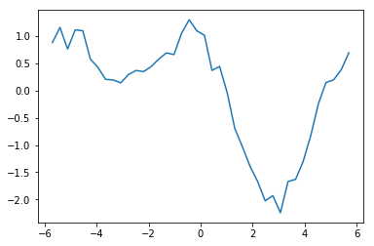
inputs=(inputs-inputs.mean(axis=0))/inputs.var(axis=0)
targets=(targets-targets.mean(axis=0))/targets.var(axis=0)

Slide 89
We can split the data in the ratio 50:25:25 by using the odd-numbered elements as training data,
the even-numbered ones that do not divide by 4 for testing,
and the rest for validation:
train=inputs[0::2,:]
test=inputs[1::4,:]
validation=inputs[3::4,:]
trainTarget=targets[0::2,:]
testTarget=targets[1::4,:]
validationTarget=targets[3::4,:]

Slide 90
To start with, we will construct a network with three nodes in the hidden layer, and run it for 101 iterations with a learning rate of 0.25.
nInputNode=1
nHiddenNode=3
nOutputNode=1
nData=int(nTotal/2)
nIteration=101
beta=0.8
eta=0.25
momentum=0.9

Slide 91
The preparation of training the MLP
error=np.zeros((nIteration,1))
validation_error=np.zeros((nIteration,1))
weight_v=(np.random.rand(nInputNode+1,nHiddenNode)-0.5)*2/np.sqrt(nInputNode)
weight_w=(np.random.rand(nHiddenNode+1,nOutputNode)-0.5)*2/np.sqrt(nHiddenNode)
input_MLP=np.concatenate((train,-np.ones((nData,1))),axis=1)
validation=np.concatenate((validation,-np.ones((np.shape(validation)[0],1))),axis=1)
update_v=np.zeros((np.shape(weight_v)))
update_w=np.zeros((np.shape(weight_w)))

Slide 92
Training the MLP
for n in range(nIteration):
hidden_MLP=np.dot(input_MLP,weight_v)
hidden_MLP=1.0/(1.0+np.exp(-beta*hidden_MLP))
hidden_MLP=np.concatenate((hidden_MLP,-np.ones((nData,1))),axis=1)
output_MLP=np.dot(hidden_MLP,weight_w)
error[n,0]=0.5*np.sum((output_MLP-trainTarget)**2)/nData
deltaOutput=(output_MLP-trainTarget)/nData
deltaHidden=beta*hidden_MLP*(1-hidden_MLP)*(np.dot(deltaOutput,np.transpose(weight_w)))
update_v=eta*(np.dot(np.transpose(input_MLP),deltaHidden[:,:-1]))+momentum*update_v
update_w=eta*(np.dot(np.transpose(hidden_MLP),deltaOutput))+momentum*update_w
weight_v-=update_v
weight_w-=update_w

Slide 93
Validation Checking
validation_Hidden=np.dot(validation,weight_v)
validation_Hidden=1.0/(1.0+np.exp(-beta*validation_Hidden))
validation_Hidden=np.concatenate((validation_Hidden,-np.ones((np.shape(validation)[0],1))),axis=1)
validation_Output=np.dot(validation_Hidden,weight_w)
validation_error[n,0]=0.5*np.sum((validation_Output-validationTarget)**2)/np.shape(validation)[0]

Slide 94
Testing
test=np.concatenate((test,-np.ones((np.shape(test)[0],1))),axis=1)
test_Hidden=np.dot(test,weight_v)
test_Hidden=1.0/(1.0+np.exp(-beta*test_Hidden))
test_Hidden=np.concatenate((test_Hidden,-np.ones((np.shape(test)[0],1))),axis=1)
test_Output=np.dot(test_Hidden,weight_w)
test_error=0.5*np.sum((test_Output-testTarget)**2)/np.shape(test)[0]
print(test_error)

Slide 95
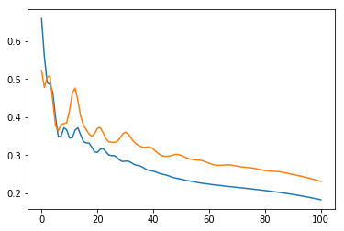

Slide 96
we can see that the network is learning, since the error is decreasing.
We now need to do two things:
work out how many hidden nodes we need,
and decide how long to train the network for.
Learning should stop when the validation set error starts to increase.
The important point is that we keep track of the validation error and stop when it starts to increase.

Slide 97
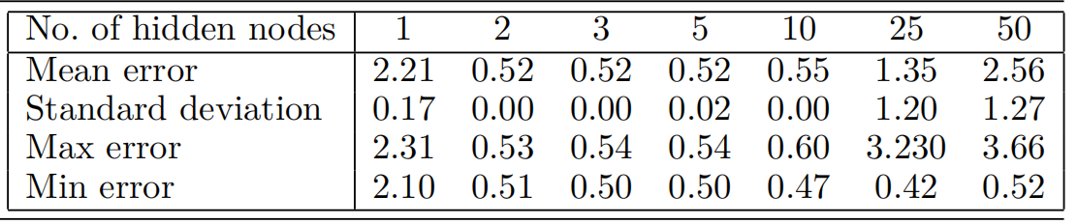
finding the right size of network
remember that the weights are initialised randomly, and so the fact that a particular size of network gets a good solution once does not mean it is the right size, it could have been a lucky starting point.
So each network size is run 10 times, and the average is monitored.

Slide 98
Based on these numbers, we would select a network with a small number of hidden nodes,
certainly between 2 and 10 (and the smaller the better, in general), since their maximum error is much smaller than a network with just 1 hidden node.
The answer is 2 hidden nodes.
Note also that the error increases once too many hidden nodes are used, since the network has too much variation for the problem.
You can also do the same kind of experimentation with more hidden layers.

Slide 99
4.4.2 Classification with the MLP
1-of-N encoding
A separate node is used to represent each possible class, and the target vectors consist of zeros everywhere except for in the one element that corresponds to the correct class, e.g., (0, 0, 0, 1, 0, 0)
the hard-max activation function
since the neuron with the highest activation is chosen to fire and the rest are ignored
the soft-max function,
which has the effect of scaling the output of each neuron according to how large it is in comparison to the others, and making the total output sum to 1.
So if there is one clear winner, it will have a value near 1, while if there are several values that are close to each other, they will each have a value of about 1/p, where p is the number of output neurons that have similar values.

Slide 100
Notes when performing classification
Suppose that we are doing two-class classification, and 90% of our data belongs to class 1.
(This can happen: for example in medical data, most tests are negative in general.)
In that case, the algorithm can learn to always return the negative class, since it will be right 90% of the time, but still a completely useless classifier!
So you should generally make sure that you have approximately the same number of each class in your training set.
This can mean discarding a lot of data from the over-represented class

Slide 101
There is an alternative solution, known as novelty detection,
which is to train the MLP on the data in the negative class only,
and to assume that anything that looks different to that is a positive example.

Slide 102
4.4.3 A Classification Example: The Iris Dataset
This one is concerned with classifying examples of three types of iris (flower) by the length and width of the sepals and petals and is called iris.
First, Load the data from the file
iris=np.loadtxt('iris_proc.data',delimiter=',')
In the dataset, the last column is the class ID, and the others are the four measurements.

Slide 103
Normalising the input Data
iris[:,:4]=iris[:,:4]-iris[:,:4].mean(axis=0)
irisMax=np.concatenate((iris.max(axis=0)*np.ones((1,5)),np.abs(iris.min(axis=0))*np.ones((1,5))),axis=0).max(axis=0)
iris[:,:4]=iris[:,:4]/irisMax[:4]

Slide 104
Convert the targets into 1-of-N encoding
To convert the targets into 1-of-N encoding, from their current encoding as class 1, 2, or 3.
irisTargets=np.zeros((np.shape(iris)[0],3))
indices=np.where(iris[:,4]==0)
irisTargets[indices,0]=1
indices=np.where(iris[:,4]==1)
irisTargets[indices,1]=1
indices=np.where(iris[:,4]==2)
irisTargets[indices,2]=1

Slide 105
Randomise the order before splitting them into sets
to ensure that there are not too many of one class in one of the sets
order=np.arange(np.shape(iris)[0])
np.random.shuffle(order)
iris=iris[order,:]
irisTargets=irisTargets[order,:]

Slide 106
To separate the data into training, testing, and validation sets
train=iris[::2,0:4]
trainTargets=irisTargets[::2]
validation=iris[1::4,0:4]
validationTargets=irisTargets[1::4]
test=iris[3::4,0:4]
testTargets=irisTargets[3::4]

Slide 107
initializtin of training MLP
nInputNode=4
nHiddenNode=4
nOutputNode=3
nData=int(nTotal/2)
nIteration=400
beta=0.8
eta=0.25
momentum=0.9
error=np.zeros((nIteration,1))
validation_error=np.zeros((nIteration,1))

Slide 108
weight_v=(np.random.rand(nInputNode+1,nHiddenNode)-0.5)*2/np.sqrt(nInputNode)
weight_w=(np.random.rand(nHiddenNode+1,nOutputNode)-0.5)*2/np.sqrt(nHiddenNode)
input_MLP=np.concatenate((train,-np.ones((nData,1))),axis=1)
validation=np.concatenate((validation,-np.ones((np.shape(validation)[0],1))),axis=1)
update_v=np.zeros((np.shape(weight_v)))
update_w=np.zeros((np.shape(weight_w)))

Slide 109
training of MLP for classification
for n in range(nIteration):
hidden_MLP=np.dot(input_MLP,weight_v)
hidden_MLP=1.0/(1.0+np.exp(-beta*hidden_MLP))
hidden_MLP=np.concatenate((hidden_MLP,-np.ones((nData,1))),axis=1)
output_MLP=np.dot(hidden_MLP,weight_w)
normalisers = np.sum(np.exp(output_MLP),axis=1)*np.ones((1,np.shape(output_MLP)[0]))
output_MLP=np.transpose(np.transpose(np.exp(output_MLP))/normalisers)

Slide 110
error[n,0]=0.5*np.sum((output_MLP-trainTargets)**2)/nData
deltaOutput=(output_MLP-trainTargets)*(output_MLP*(-output_MLP)+output_MLP)/nData
deltaHidden=beta*hidden_MLP*(1-hidden_MLP)*(np.dot(deltaOutput,np.transpose(weight_w)))
update_v=eta*(np.dot(np.transpose(input_MLP),deltaHidden[:,:-1]))+momentum*update_v
update_w=eta*(np.dot(np.transpose(hidden_MLP),deltaOutput))+momentum*update_w
weight_v-=update_v
weight_w-=update_w

Slide 111
Validation Tracking
validation_Hidden=np.dot(validation,weight_v)
validation_Hidden=1.0/(1.0+np.exp(-beta*validation_Hidden))
validation_Hidden=np.concatenate((validation_Hidden,-np.ones((np.shape(validation)[0],1))),axis=1)
validation_Output=np.dot(validation_Hidden,weight_w)
validationNormalisers = np.sum(np.exp(validation_Output),axis=1)*np.ones((1,np.shape(validation_Output)[0]))
validation_Output=np.transpose(np.transpose(np.exp(validation_Output))/validationNormalisers)
validation_error[n,0]=0.5*np.sum((validation_Output-validationTargets)**2)/np.shape(validation)[0]

Slide 112
testing the result
test=np.concatenate((test,-np.ones((np.shape(test)[0],1))),axis=1)
test_Hidden=np.dot(test,weight_v)
test_Hidden=1.0/(1.0+np.exp(-beta*test_Hidden))
test_Hidden=np.concatenate((test_Hidden,-np.ones((np.shape(test)[0],1))),axis=1)
test_Output=np.dot(test_Hidden,weight_w)
testNormalisers = np.sum(np.exp(test_Output),axis=1)*np.ones((1,np.shape(test_Output)[0]))
test_Output=np.transpose(np.transpose(np.exp(test_Output))/testNormalisers)
test_error=0.5*np.sum((test_Output-testTargets)**2)/np.shape(test)[0]

Slide 113
Confusion Matrix
nClasses = np.shape(testTargets)[1]
if nClasses==1:
nClasses = 2
test_Output = np.where(test_Output>0.5,1,0)
else:
# 1-of-N encoding
outputs = np.argmax(test_Output,1)
targets = np.argmax(testTargets,1)

Slide 114
confusionMatrix = np.zeros((nClasses,nClasses))
for i in range(nClasses):
for j in range(nClasses):
confusionMatrix[i,j] = np.sum(np.where(outputs==i,1,0)*np.where(targets==j,1,0))

Slide 115
Output the results
print('testError=',test_error)
plt.plot(range(nIteration),error,range(nIteration),validation_error)
print ("Confusion matrix is:")
print (confusionMatrix)
print ("Percentage Correct: ",np.trace(confusionMatrix)/np.sum(confusionMatrix)*100,'%')

Slide 116
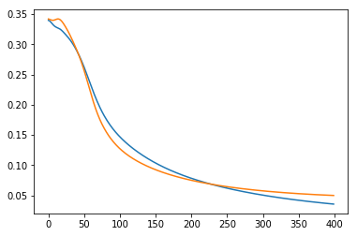
testError= 0.03494997479726993
Confusion matrix is:
[[11. 0. 0.]
[ 0. 14. 0.]
[ 0. 0. 12.]]
Percentage Correct: 100.0 %

Slide 117
4.4.4 Time-Series Prediction
we have a set of data that show how something varies over time,
and we want to predict how the data will vary in the future.
The problem is that
even if there is some regularity in the time-series, it can appear over many different scales. i.e. daily, monthly, seasonly or yearly
The other problems with the data are practical.
How many datapoints should we look at to make the prediction (i.e., how many inputs should there be to the neural network)
and how far apart in time should we space those inputs (i.e., should we use every second datapoint, every 10th, or all of them)?

Slide 118
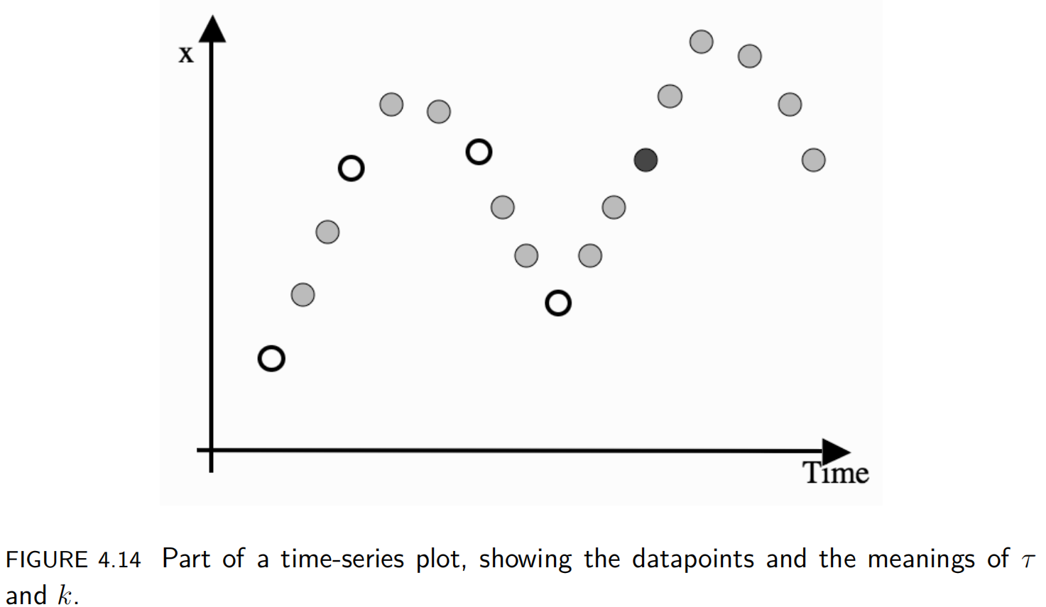
we are predicting y using a neural network that is written as a function f(·):
y = x(t + τ ) = f(x(t), x(t − τ ), . . . , x(t − kτ )),
where the two questions about how many datapoints and how far apart they should be come down to choices about τ and k

Slide 119
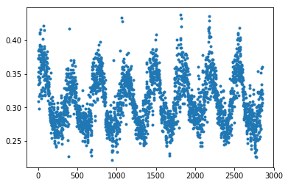
"""Load the Data from the data file"""
PNozone=np.loadtxt('PNOz.dat')
plt.figure(1)
plt.plot(np.arange(np.shape(PNozone)[0]),PNozone[:,2],'.')

Slide 120
"""To prepare the data for MLP training y=f(x(s-t),x(s-2t),...,x(s-kt))"""
data=np.ones((1,np.shape(PNozone)[0]))*PNozone[:,2]
data=data-data.mean(axis=1)
data=data/(np.abs(data).max(axis=1))
t=3
k=4
nUnit=int(np.shape(data)[1]/(t*(k+1)))
data=data[:,:nUnit*t*(k+1)]
dataRaw=[]
for n in range(t):
dataRaw=np.concatenate((dataRaw,data[0,n::t]))
dataRaw=np.reshape(dataRaw,(int(np.shape(data)[1]/(k+1)),k+1))
nTotal=np.shape(dataRaw)[0]

Slide 121
"""Prepare the train, validation and test set
order=np.arange(nTotal)
np.random.shuffle(order)
dataRaw=dataRaw[order,:]"""
nTest=int(nTotal/3)
train=dataRaw[0:-nTest:2,:k]
test=dataRaw[-nTest:,:k]
validation=dataRaw[1:-nTest:2,:k]
trainTarget=dataRaw[0:-nTest:2,k]
nTrainTarget=np.shape(trainTarget)[0]
trainTarget=np.reshape(trainTarget,(nTrainTarget,1))
testTarget=dataRaw[-nTest:,k]
ntestTarget=np.shape(testTarget)[0]
testTarget=np.reshape(testTarget,(ntestTarget,1))
validationTarget=dataRaw[1:-nTest:2,k]
nvalidationTarget=np.shape(validationTarget)[0]
validationTarget=np.reshape(validationTarget,(nvalidationTarget,1))

Slide 122
"""Initialize the MLP"""
nInputNode=k
nHiddenNode=int(np.sqrt(k+1)+0.5)
nOutputNode=1
nData=np.shape(train)[0]
nIteration=100
beta=0.8
eta=0.25
momentum=0.9
error=np.zeros((nIteration,1))
validation_error=np.zeros((nIteration,1))

Slide 123
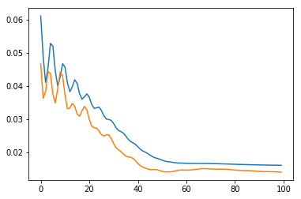
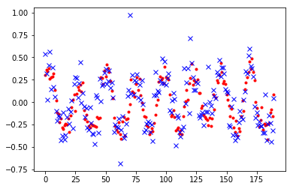

Slide 124
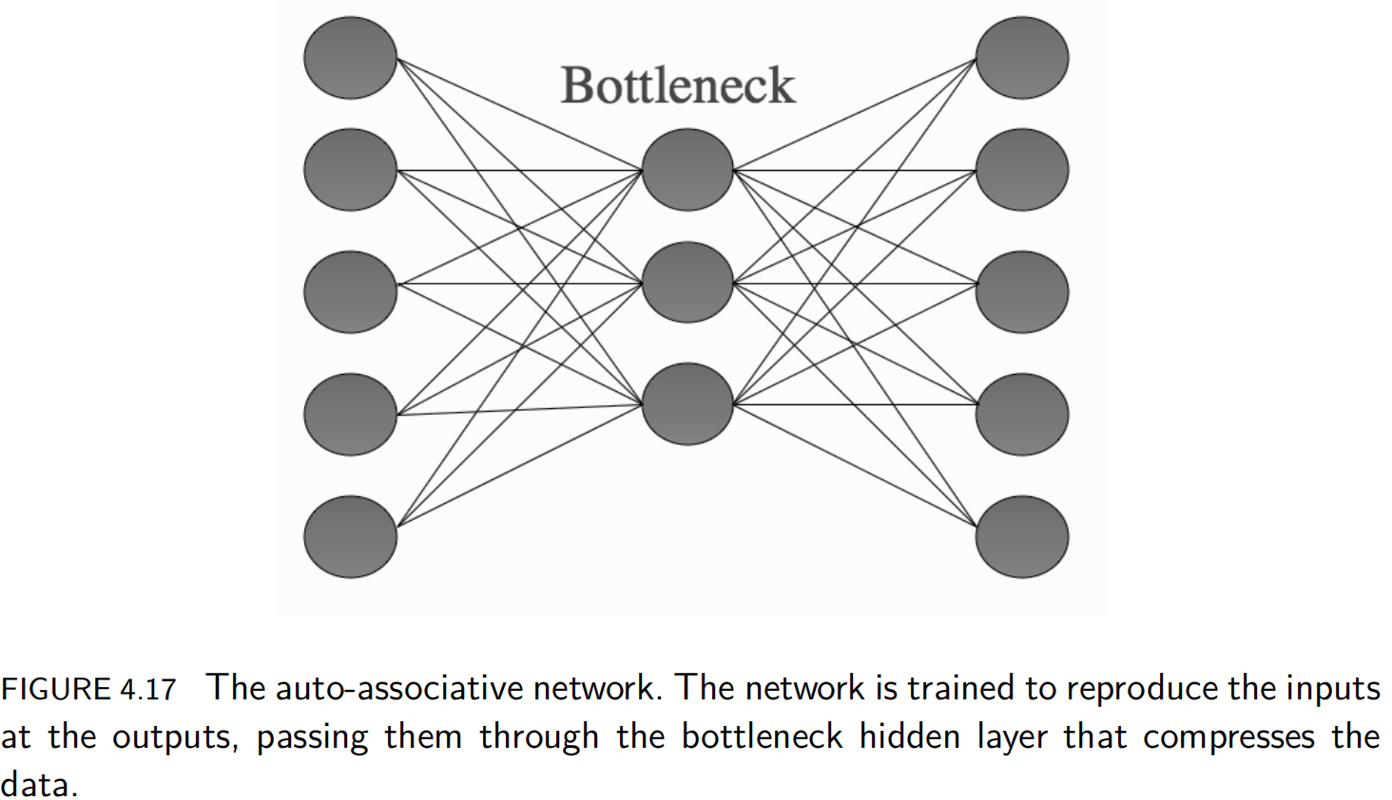
4.4.5 Data Compression: The Auto-Associative Network
we train the network to reproduce the inputs at the output layer (called auto-associative learning; sometimes the network is known as an autoencoder).
we use a hidden layer that has fewer neurons than the input layer.
This bottleneck hidden layer has to represent all of the information in the input, so that it can be reproduced at the output.

Slide 125
The hidden layer are finding a different (often lower dimensional) representation of the input data that extracts important components of the data, and ignores the noise.
This auto-associative network can be used to compress images and other data.
For Example: the 2D image is turned into a 1D vector of inputs
by cutting the image into strips and sticking the strips into a long line.
The values of this vector are the intensity (colour) values of the image, and these are the input values.

Slide 126
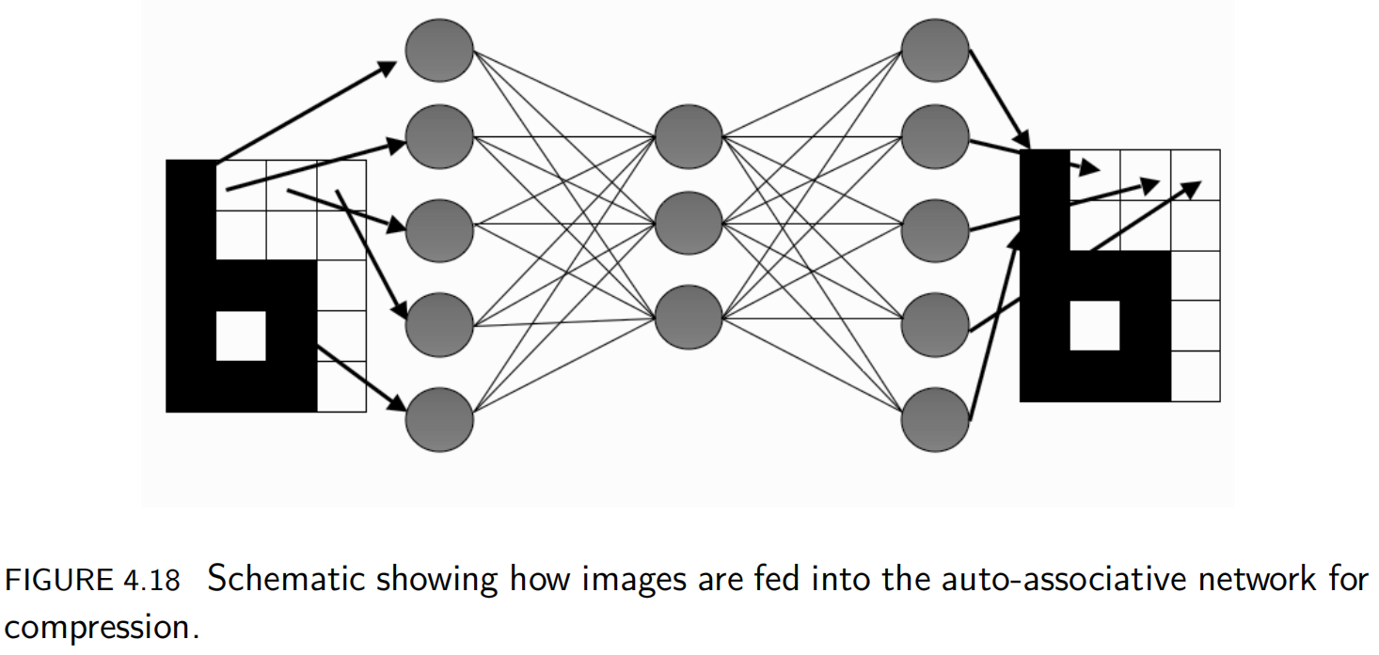

Slide 127
The network learns to reproduce the same image at the output, and the activations of the hidden nodes are recorded for each image.
After training, we can throw away the input nodes and first set of weights of the network.
If we input some values in the hidden nodes (their activations for a particular image), then by feeding these activations forward through the second set of weights, the correct image will be reproduced on the output.
So all we need to store are
the set of second-layer weights
and the activations of the hidden nodes for each image, which is the compressed version.

Slide 128
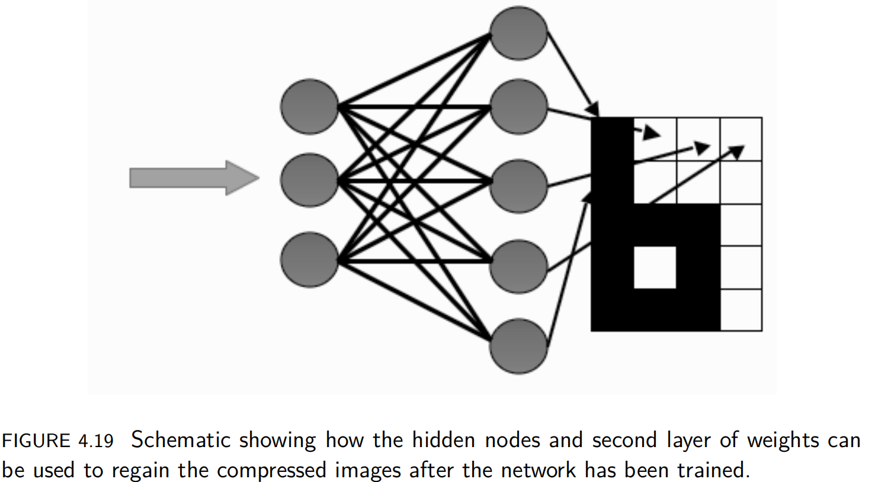

Slide 129
Auto-associative networks can also be used to denoise images,
since, after training, the network will reproduce the trained image that best matches the current (noisy) input.
We don't throw away the first set of weights this time,
but if we feed a noisy version of the image into the inputs,
then the network will produce the image that is closest to the noisy version at the outputs,
which will be the version it learnt on,
which is uncorrupted by noise.

